Slide 1

Tech 36 CSVTU
Team Details
Team name: The Hacktivists
Team leader name: Aarushi Jain
Team member : Apoorva Shrivastava
Problem Statement: Reviving the Indian Cow Breed for a Sustainable Future

Slide 2
Brief about your solution
Reviving Indian cow breeds requires awareness, scientific breeding, sustainable applications, technology, and policy support. Education campaigns can highlight their socio-economic and environmental benefits, while improved breeding enhances genetic purity and productivity. Promoting cow-based products in farming, Ayurveda, and renewable energy creates economic incentives. Technology like AI and blockchain aids breed management and market transparency. Supportive policies and financial aid encourage farmers to sustain indigenous breeds, ensuring a self-reliant, sustainable future.

Slide 3
.
Opportunities
a.How different is it from any of the other existing ideas?
Our website features a specialized Cow Care Calculator that estimates feed, veterinary, and shelter costs for different breeds. A comprehensive Indian cow breed database provides details on weight, height, milk yield, and origin. The Cow Nutrition Table helps farmers plan better feeding with insights on protein, energy, and fiber content
b.How will it be able to solve the problem?
It will be able to solve the problem as it deals with the following :
Lack of Awareness → Educates farmers with a detailed Indian cow breed database, highlighting economic, environmental, and health benefits.
High Maintenance Costs → The Cow Care Calculator helps estimate and plan for feed, veterinary, and shelter expenses, making cow-rearing more feasible.
Poor Nutrition Management → The Cow Nutrition Table provides breed-specific dietary insights, improving cow health and milk production.
c. USP of the proposed solution
All-in-One Cow Conservation Platform – Combines awareness, cost estimation, and nutrition management. It has a Smart Cow Care Calculator which Estimates feed, veterinary, and shelter costs based on breed and a Exclusive Indian Cow Breed Database – Detailed insights on weight, milk yield, and sustainability benefits.

Slide 4
List of features offered by the solution
1.Cow Care Calculator
Estimates feed cost based on breed and number of cows
Calculates veterinary expenses for vaccinations and treatments
Provides shelter cost estimation considering climate and breed needs
2. Indian Cow Breed Database
Detailed information on weight, height, color, milk yield, and origin
Highlights breed-specific benefits for farmers and sustainability
3. Cow Nutrition Table
Displays protein, energy, and fiber content for optimal feeding
Includes special notes on dietary requirements for different breeds
4.Chatbot Feature Highlights: – Get instant answers about indigenous cow breeds, their benefits, and how to care for them. Personalized Guidance :Our chatbot provides breed-specific care tips, nutrition advice, and answers to common questions.
5. Awareness & Education
Promotes traditional cow-based organic farming
Educates on Ayurvedic and environmental benefits of Indian cows

Slide 5
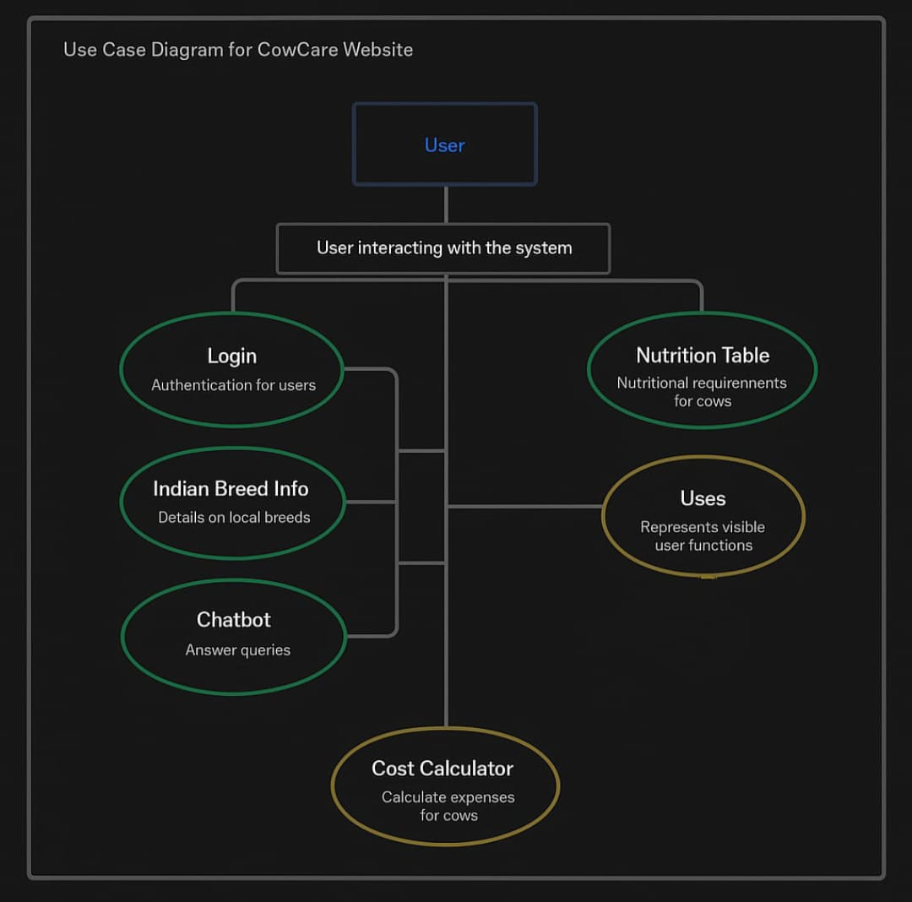
Process flow diagram or Use-case diagram

Slide 6
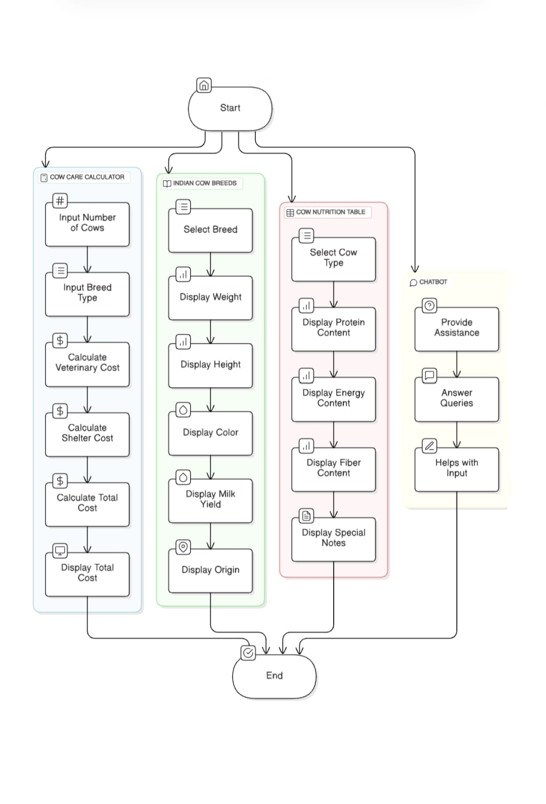
Architecture diagram of the proposed solution

Slide 7
.
Technologies to be used in the solution
- Core web technologies : HTML, CSS, JavaScript
- Web Hosting : Vercel
- Chatbot - botpress
- Project build on : IDX
.

Slide 8
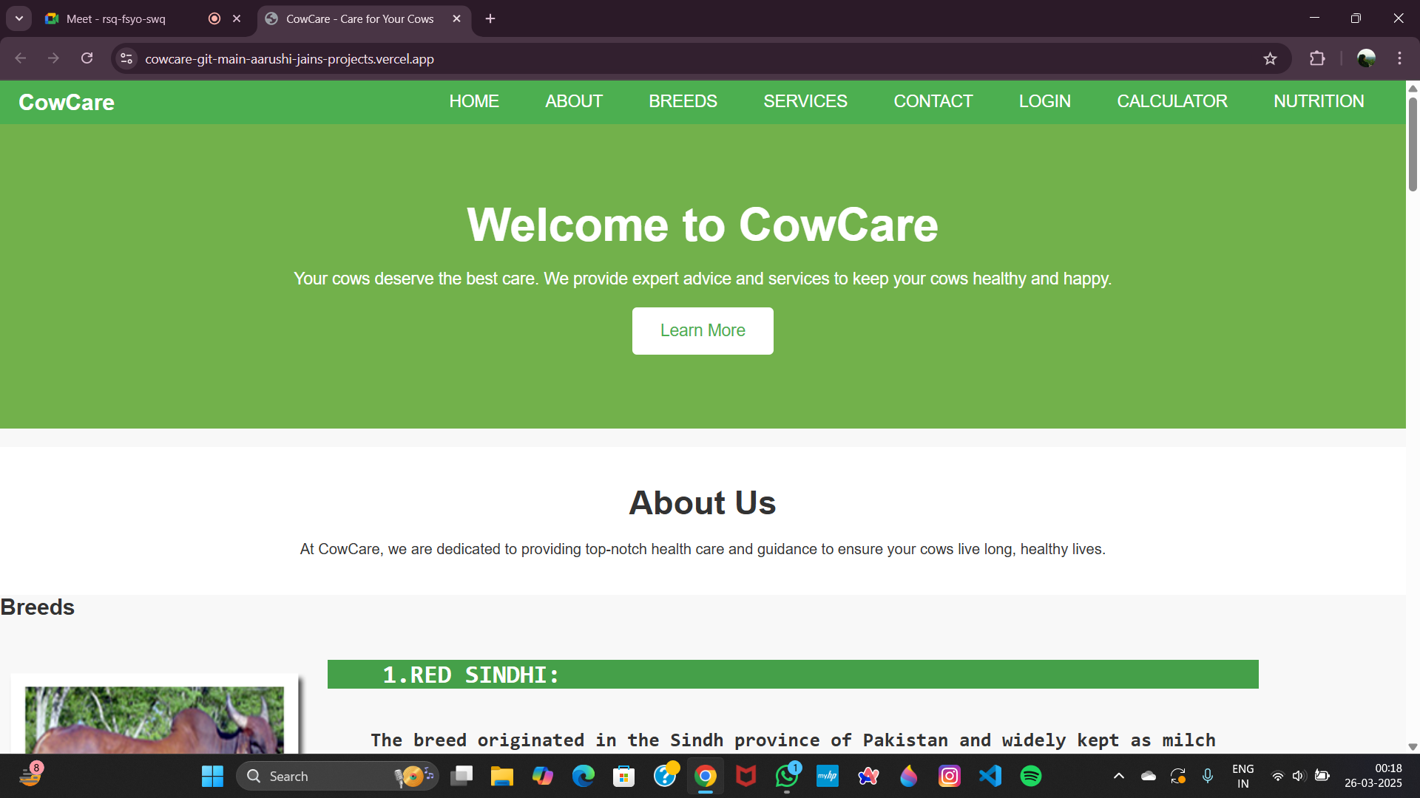
Snapshots of the MVP

Slide 9
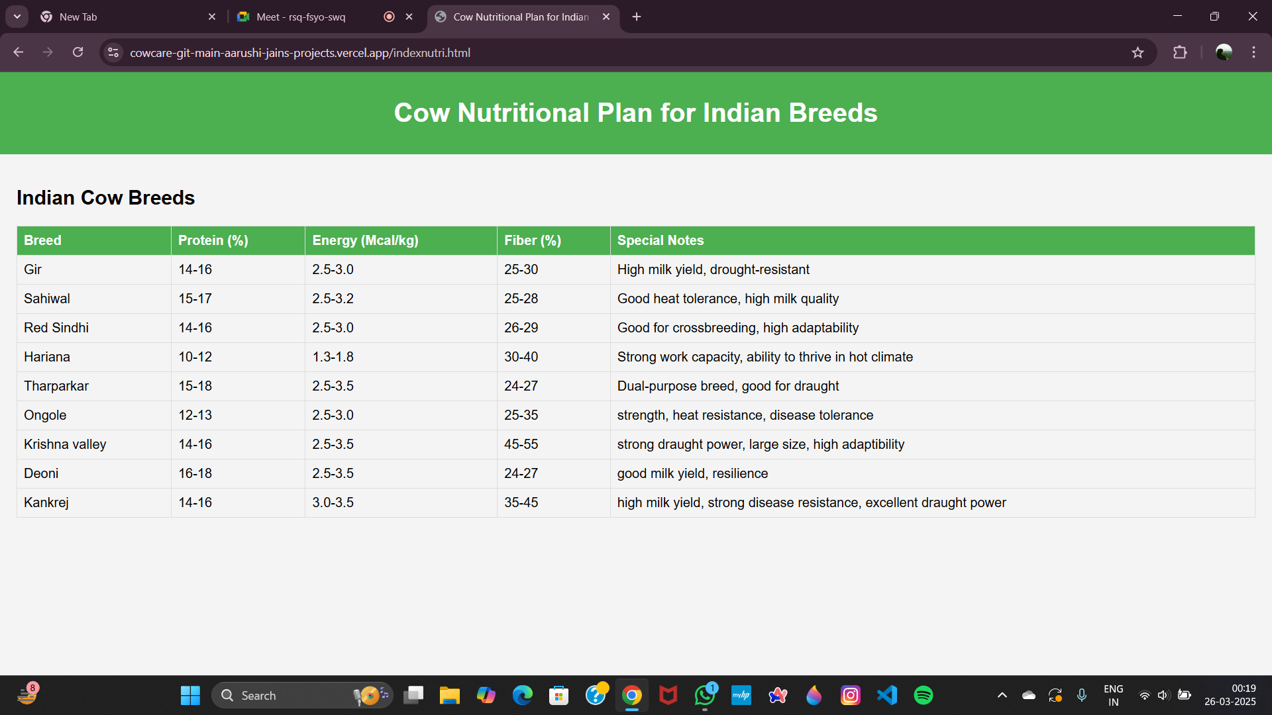
Snapshots of the MVP

Slide 10
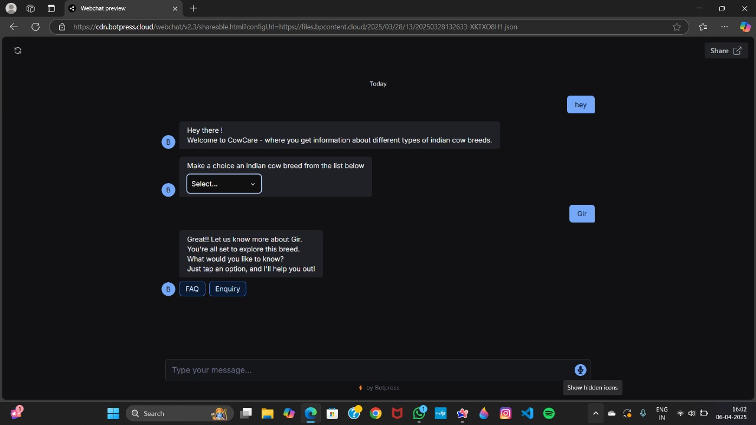
Snapshots of the MVP

Slide 11
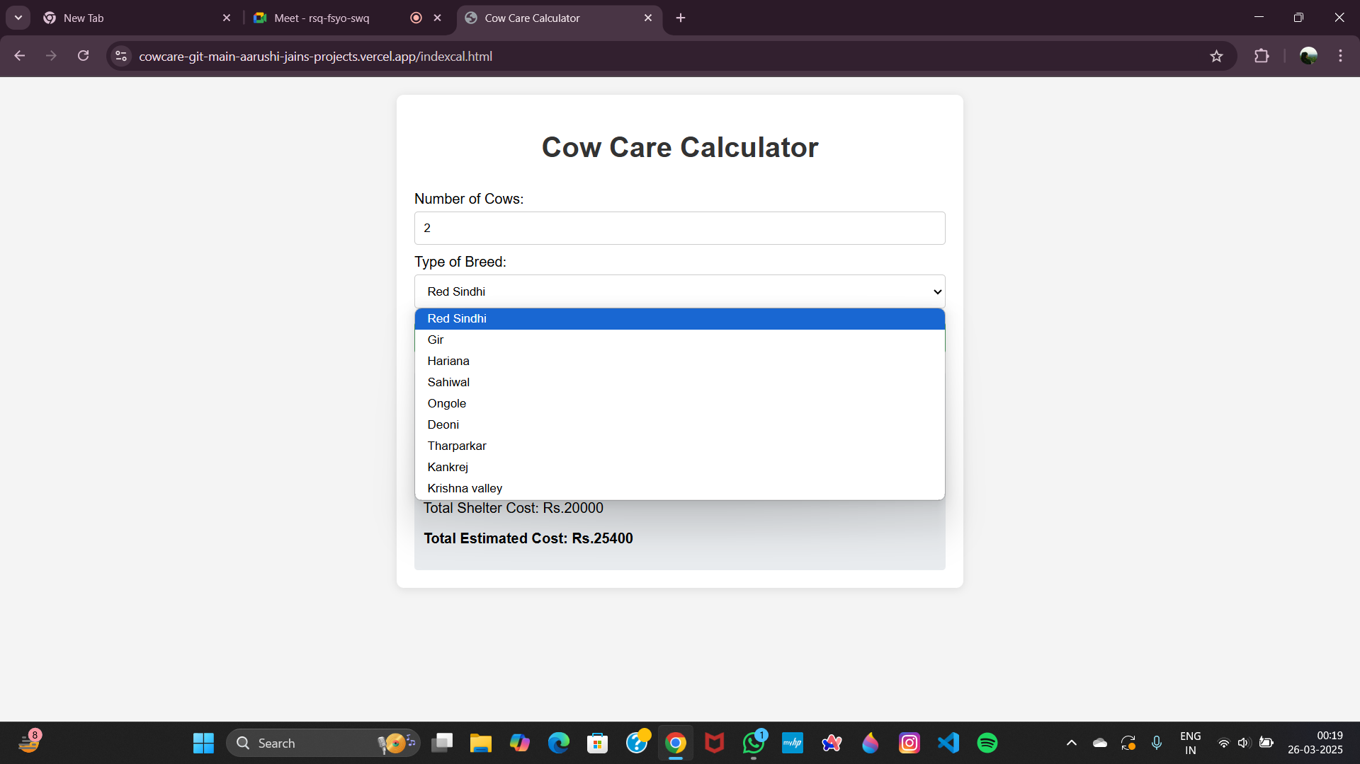
Snapshots of the MVP

Slide 12
THANKYOU!
.

